Slide 1

Drift Racing with Machine Learning
Presentation by:
Tan Wei Jie
Project ID:
H041930

Slide 2
Overview
Introduction
Literature Review and Proposed Solution(s)
Brief Overview of Implementation
Methodology, Experiments
Implementation of Competition
Conclusion

Slide 3
Introduction
Introduction

Slide 4
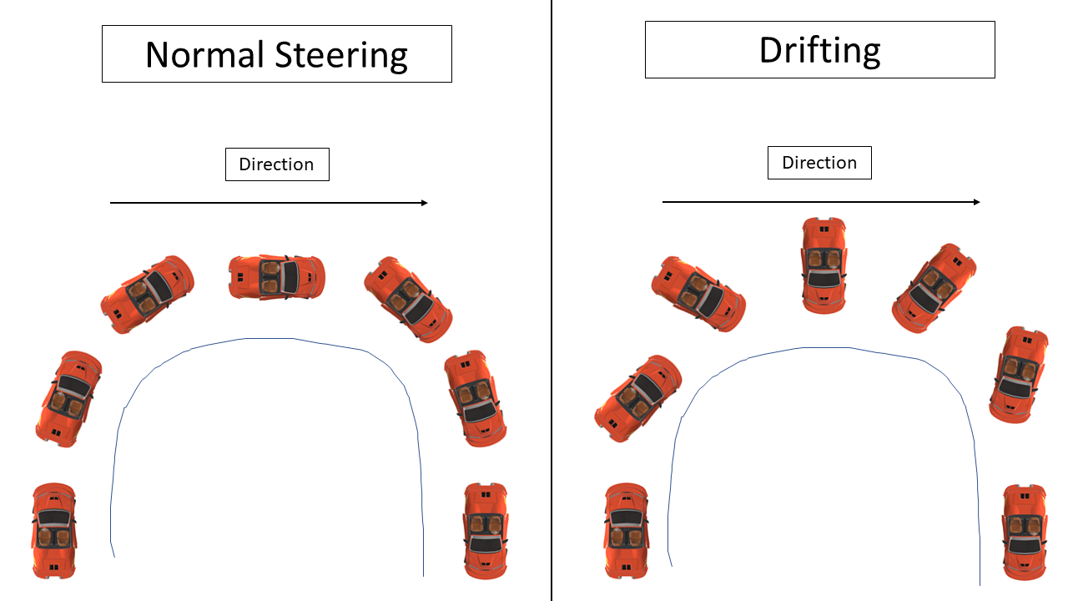
What is Drifting?
A method of controlling the car where driver oversteers, usually to navigate a bend
Occurs when traction between the tires and the ground is lost
Sometimes not intentional…

Slide 5
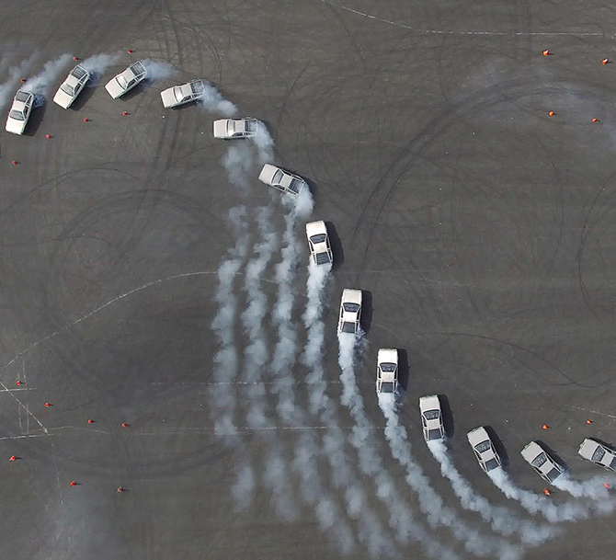
Credit: Jonathan Goh, MARTYkhana project

Slide 6
Project Objective
Come up with autonomous RC car competition
For students of NUS School of Computing and Faculty of Engineering
DRIFTING!

Slide 7
Deliverables
Design and implement an autonomous RC car competition, with drifting
Design racetrack
Competition format and rules
List of hardware
Prove feasibility with our contestant
Procuring hardware
Programming a drift controller

Slide 8
Deliverables
Design and implement an autonomous RC car competition, with drifting
Design racetrack
Competition format and rules
List of hardware
Prove feasibility with our contestant
Procuring hardware
Programming a drift controller

Slide 9
Deliverables
Design and implement an autonomous RC car competition, with drifting
Design racetrack
Competition format and rules
List of hardware
Prove feasibility with our contestant
Procuring hardware
Programming a drift controller

Slide 10
Deliverables
Design and implement an autonomous RC car competition, with drifting
Design racetrack
Competition format and rules
List of hardware
Prove feasibility with our contestant
Procuring hardware
Programming a drift controller

Slide 11
Literature Review and Proposed Solution(s)
Introduction
Literature Review and Proposed Solution(s)

Slide 12
Autonomous Drifting using Simulation Aided Reinforcement Learning
Sustained Drift based on Reinforcement Learning by Cutler and How (2016)
Original inspiration for the project
Reinforcement Learning approach to do Sustained Drifting
State information: Velocity in Car Frame, Yaw Rate, and Wheel speed
Sensors: Motion Capture System (essentially a GPS), & optical wheel encoders
Algorithm: PILCO

Slide 13
Autonomous Drifting RC Car with Reinforcement Learning
Similar experiment by Bhattacharjee, Kabara, and Jain (2018)
Attempted on other state information but failed to produce results
Solution worked with the state information provided by Cutler and How (2016) instead
Sensors: IMU
Hardware implementation largely unsuccessful
Algorithms: Double-dueling DQN, PILCO

Slide 14
Conclusion of Reinforcement Learning Framework
Need sensor for velocity in car frame and yaw rate
Cutler & How (2016) used Motion Capture System, successfully
Bhattacharjee et al (2018) tried IMU, unsuccessfully
After consultation, concluded that this approach was infeasible
2 major hardware concerns:
Cost
Mechanical Difficulty

Slide 15
Search for a New/ Novel Approach…
3 pieces of literature, a naïve solution and an improved solution

Slide 16
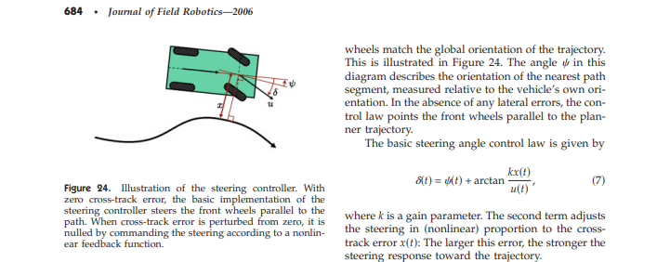
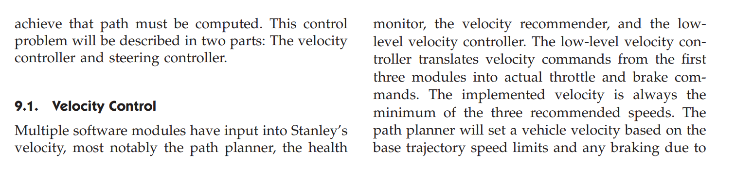
Stanley: The robot that won the DARPA grand challenge
Thrun et al (2006) describe the controller for their autonomous car using a separate velocity and steering controller
Insight: Control the steering and throttle independently to drive
Can we use this for drifting as well?

Slide 17
End to End Learning for Self-Driving Cars
Use a Convolutional Neural Network to map images from a camera attached to the car, to the controls (in particular, steering angle)
Goes by many names: Nvidia model, PilotNet, Behavioural Cloning…
Requires only camera, cheap and easy to mount!

Slide 18
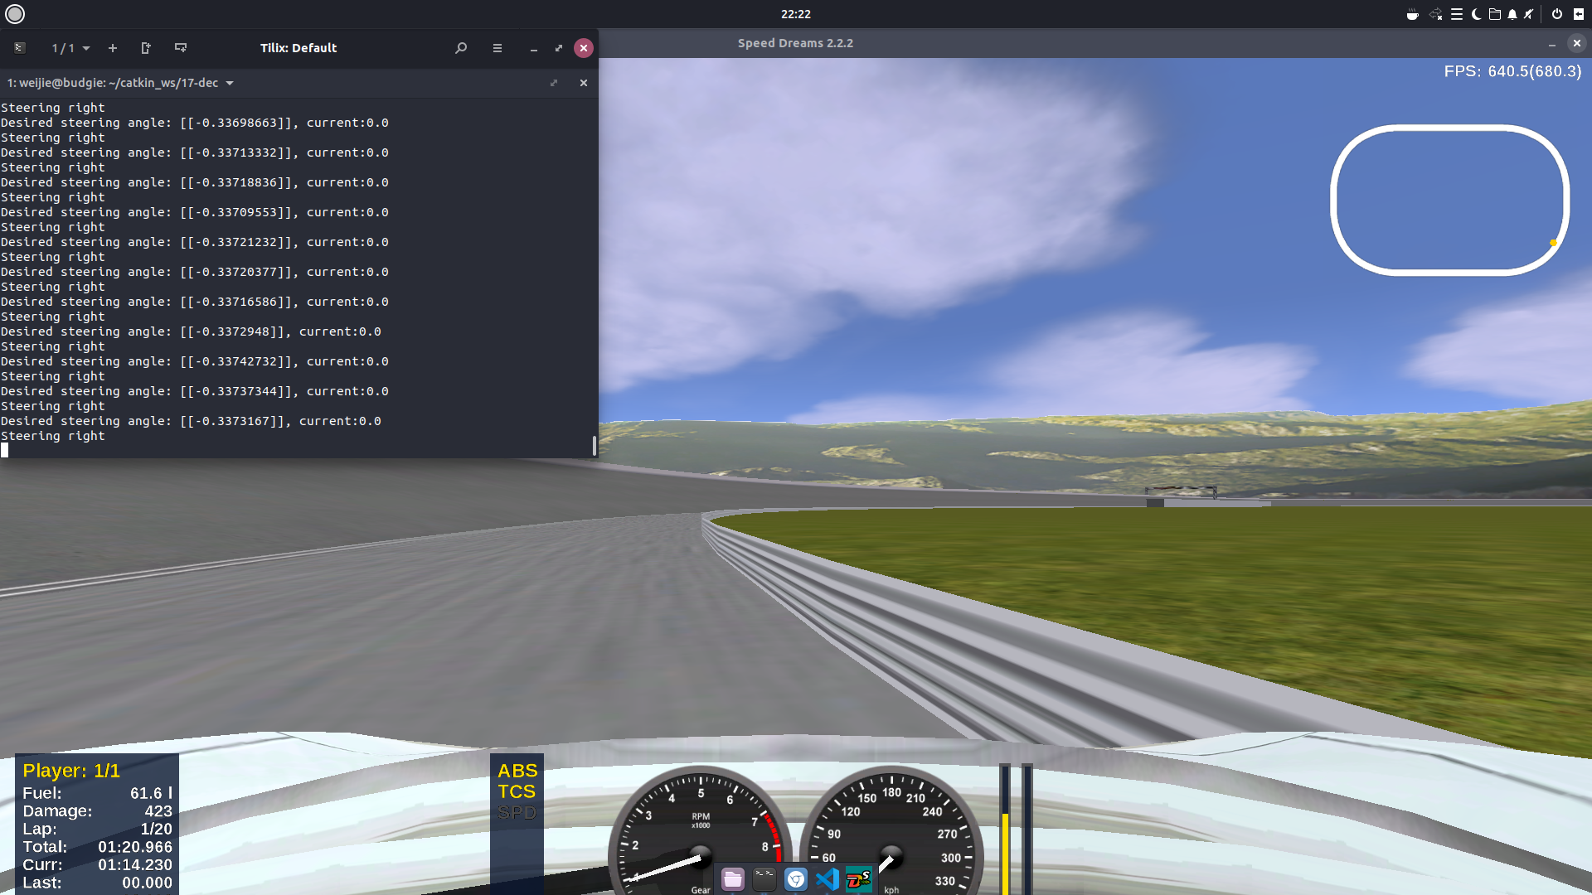
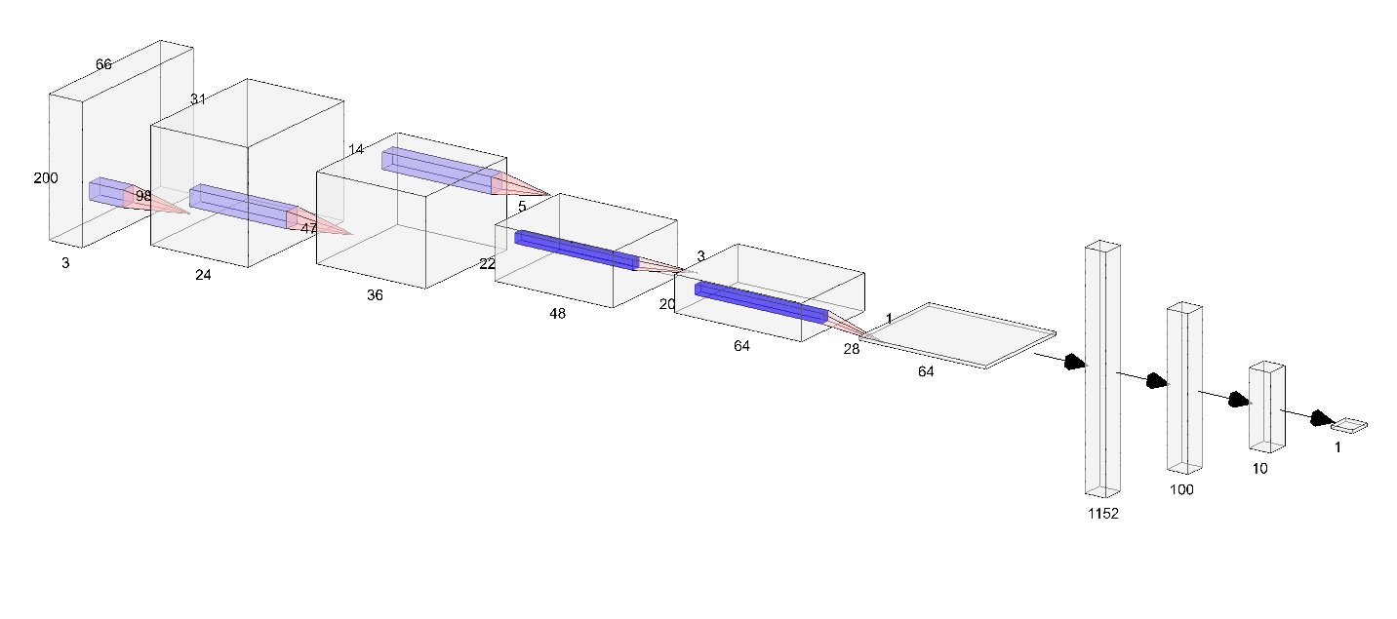
(Naïve) Proposed Solution
Use Nvidia Model to predict steering controls to make the car drift
Determine some constant speed later
Implement on Speed Dreams 2 simulator
Results do not show feasibility
Intuitively, needed to control speed
But this goes against the insight
Was the insight wrong? Why?

Slide 19
Toward Automated Vehicle Control Beyond the Stability Limits: Drifting Along a General Path
The MARTY project at Stanford
Demonstrated autonomous drifting of a life-sized car
Came up with a control law
In the process, had to understand relationship between actuators and the dynamics

Slide 20
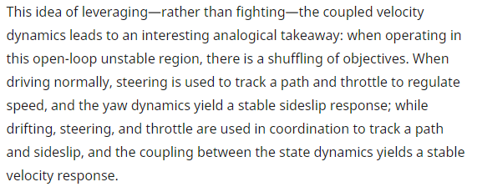

Slide 22
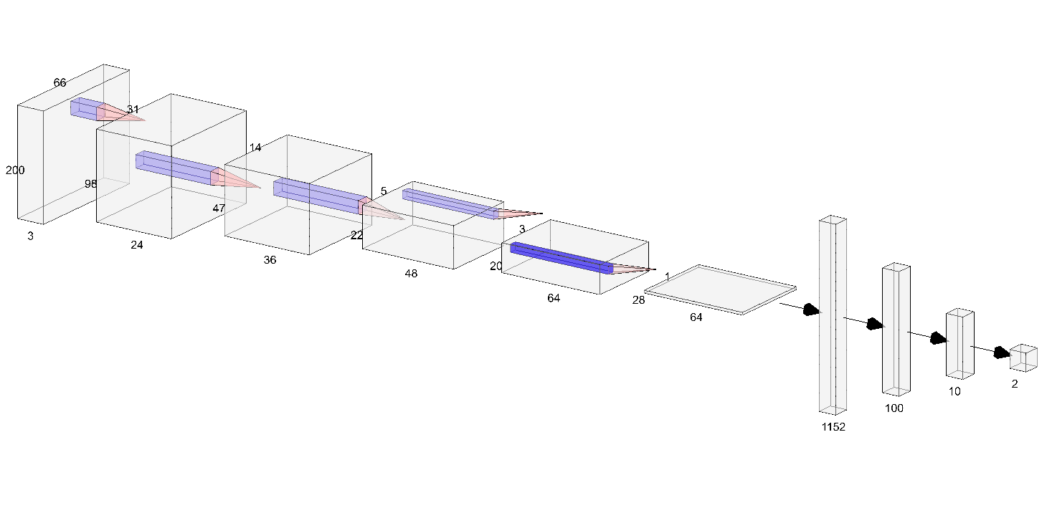
Improved Proposed Solution
Largely same as previous solution, but predict both the steering and the speed rather than the steering only
Novel approach!
Try to demonstrate feasibility of this solution on the hardware

Slide 23
Overview of Implementation
Introduction
Literature Review and Proposed Solution(s)
Overview of Implementation

Slide 24
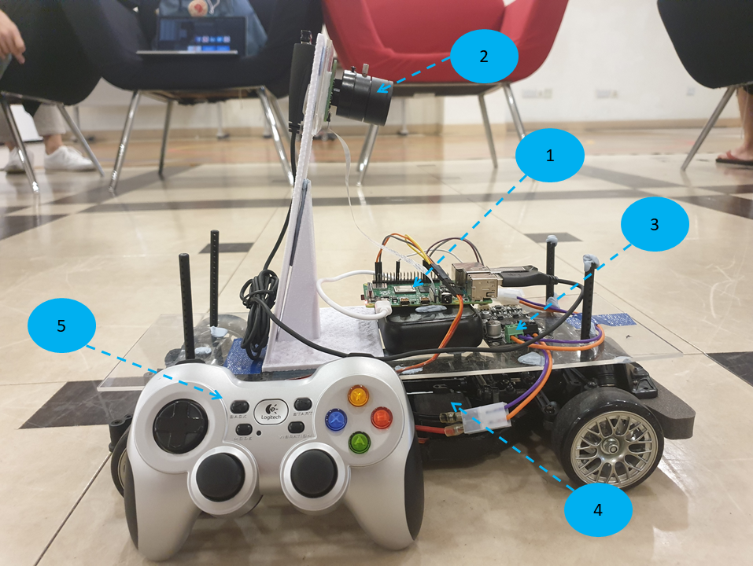

Slide 25
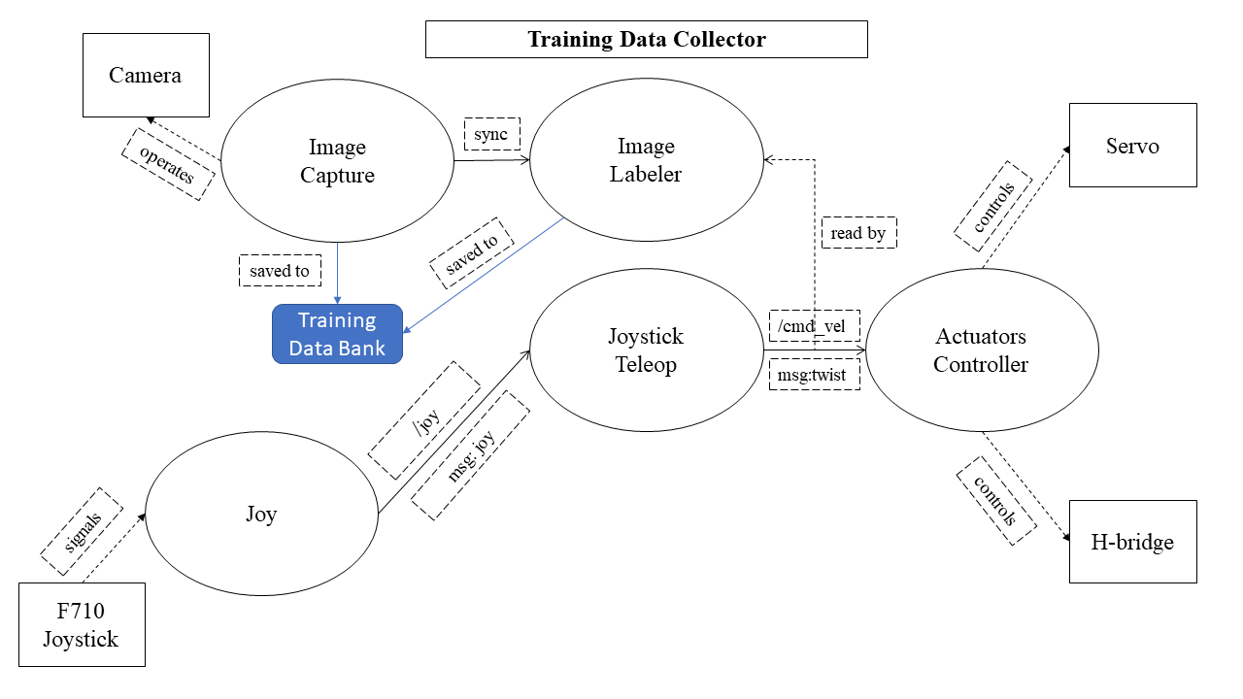

Slide 26
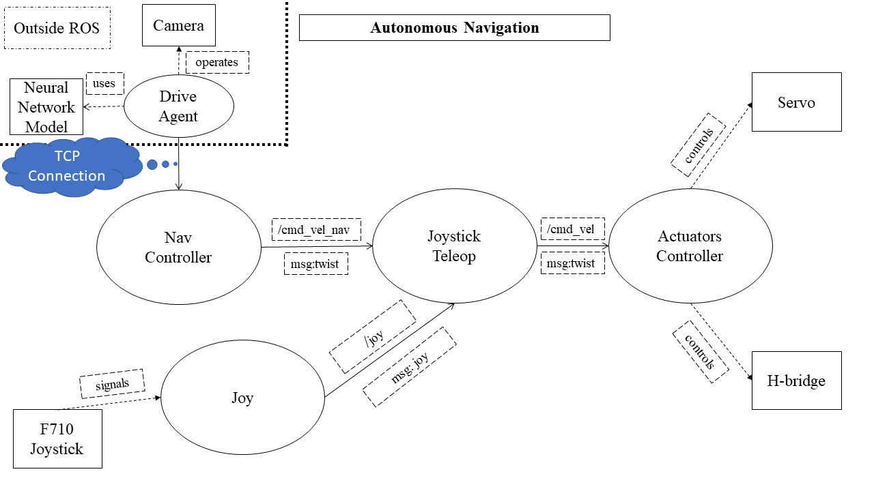

Slide 27
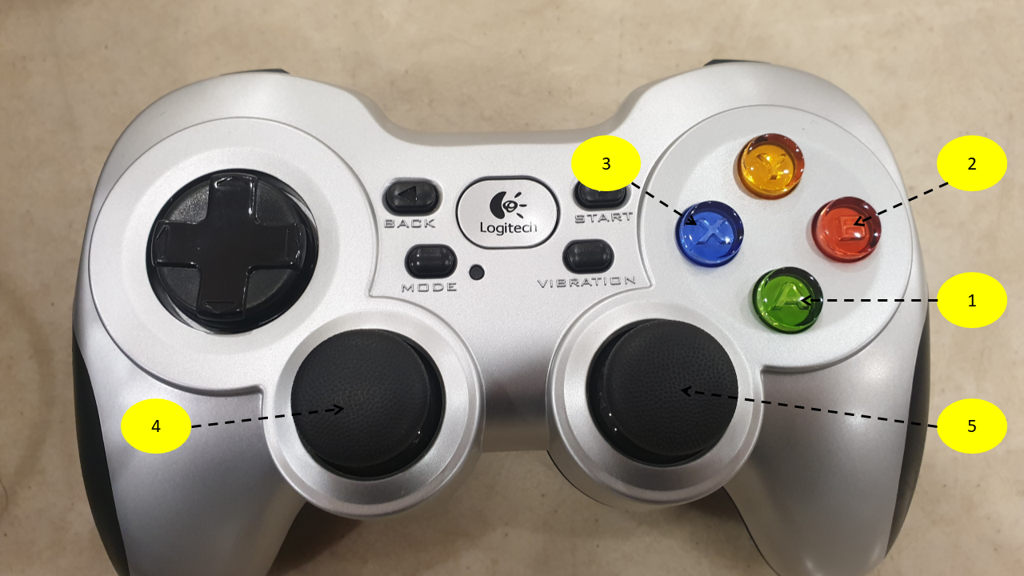

Slide 28
Experiments and Methodology
Introduction
Literature Review and Proposed Solution(s)
Overview of Implementation
Experiments and Methodology

Slide 29
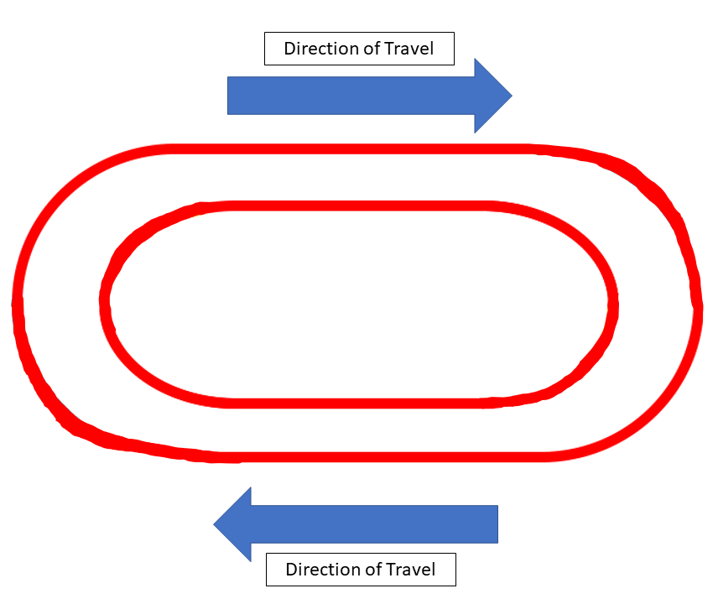
Initial Track Design
Cloth Tape
Location:
COM2-04-01 Multipurpose space

Slide 30
Experiment Procedure
Drive the car around the track to collect training data
Train the neural network using the training data
Evaluate the trained model using Autonomous Navigation
Repeat until success

Slide 31
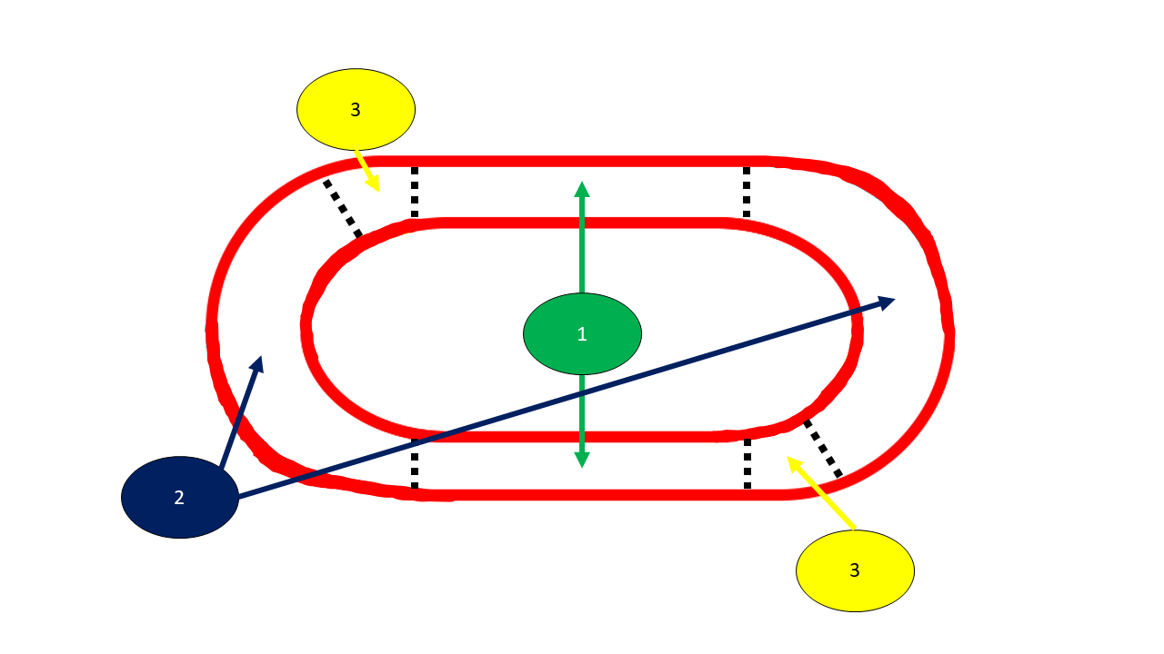
Qualitative Evaluation
Area 1: Normal Driving
Area 2: Drifting
Area 3: Recovery

Slide 32
Hypothesis and Problem Statement
We mainly want to prove feasibility of the proposed solution
We assume that the algorithm works, backed up by intuition and Universal Approximation Theorem
We will attempt the track and upon failure, modify the track incrementally until success
Ideally, we will arrive at:
Working demonstration of feasibility
Track design for the competition

Slide 33
Deliverables
Design and implement an autonomous RC car competition, with drifting
Design racetrack
Competition format and rules
List of hardware
Prove feasibility with our contestant
Procuring hardware
Programming a drift controller

Slide 34
Experiment #1

Slide 35
Results on initial track iteration
Area | Observation | Pass/Fail
1: Straight driving | Always a bias to one side instead of driving straight | Fail
2: Drifting | Does not follow the track, arbitrary drifting | Fail
3: Recovery | Fails by default since (2) is failed | Fail

Slide 36
Evaluation #1
Does not even drive straight, which should be the easiest
Set steering to close to 0
Speed non-critical
The fact that it turns might mean confusion between the Areas 1 2 3
Surmise that there is a lack of visual cues on the track
Improvement: add more visual cues for next iteration

Slide 37
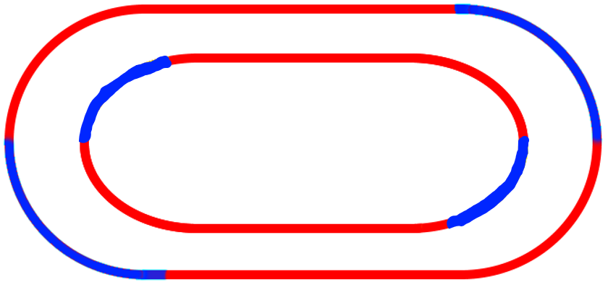
Second track iteration

Slide 38
What the car sees | What the car should do
Red on both sides | Drive normally
Red on right, blue on left | Drift
Red on left, blue on right | Recover

Slide 39

Results on Second Track Iteration
Area | Observation | Pass/Fail
1: Straight driving | Drives straight and within the tracks | Pass
2: Drifting | Performs drifting | Pass
3: Recovery | Works only occasionally | Fail

Slide 40
Evaluation #2
By adding in 1 more colour, performance greatly improves
In general, can barely complete 1 round
Why does it sometimes fail recovery?

Slide 41
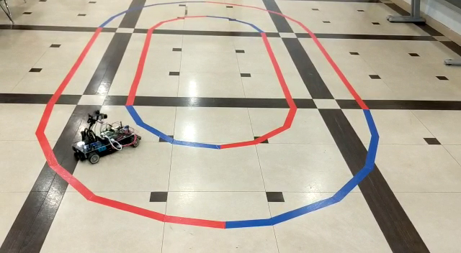
Orientation of car after drifting
Facing inwards!
Different from what we expected/wanted

Slide 42
What the car sees | What the car should do
Red on both sides | Drive normally
Red on right, blue on left | Drift
Red on left, blue on right | Recover

Slide 43
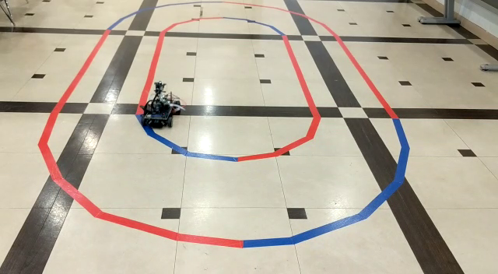
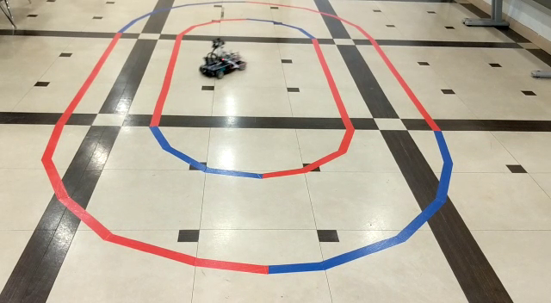
Car Turns to the Right!

Slide 44
Evaluation #2
For next iteration:
reduce confusion for recovery
take into account orientation of the car

Slide 45
Second Track Iteration

Slide 46
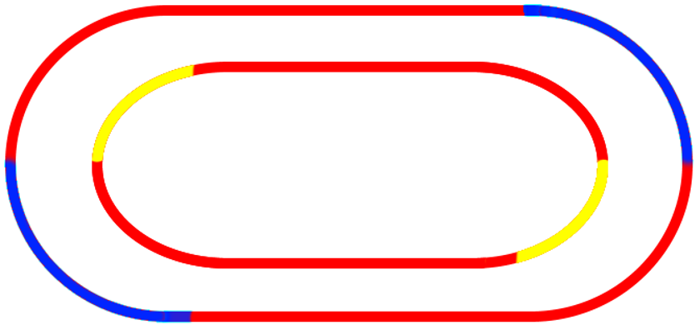
Third Track Iteration

Slide 47

Results on Third Track Iteration
Area | Observation | Pass/Fail
1: Straight driving | Drives straight and within the tracks | Pass
2: Drifting | Performs drifting | Pass
3: Recovery | Able to recover well and as needed | Pass

Slide 48
Success!
Demonstrate the potential and feasibility of Convolutional Neural Network for drifting
Earlier assumptions of lack of visual cues proven to a large extent
Idea for any general track: clearly demarcate the start and end of drifting
Implement the competition by getting CS3244 students to join

Slide 49
Deliverables
Design and implement an autonomous RC car competition, with drifting
Design racetrack
Competition format and rules
List of hardware
Prove feasibility with our contestant
Procuring hardware
Programming a drift controller

Slide 50
Deliverables
Design and implement an autonomous RC car competition, with drifting
Design racetrack
Competition format and rules
List of hardware
Prove feasibility with our contestant
Procuring hardware
Programming a drift controller

Slide 51
Noteworthy Observations
Observation #1: Robustness
When car exits the track, it can find its way back in
Likely due to slightly dirty training data

Slide 52
Noteworthy Observations
Observation #2: Validation Loss Threshold
Loss function: Mean Square Error (MSE)
Models that were successful have validation loss of at most 0.08
Still need to verify by testing, because of overfitting

Slide 53
Noteworthy Observations
Observation 3: Number of training epochs
Training of > 10 epochs shows convergence of validation loss to 0.25 – 0.278
Means that for our typical use case, training epoch greater than 10 is meaningless
Can save on turnaround time by setting a training epoch of no more than 10

Slide 54
Implementation of Competition
Introduction
Literature Review and Proposed Solution(s)
Overview of Implementation
Experiments and Methodology
Implementation of Competition

Slide 55

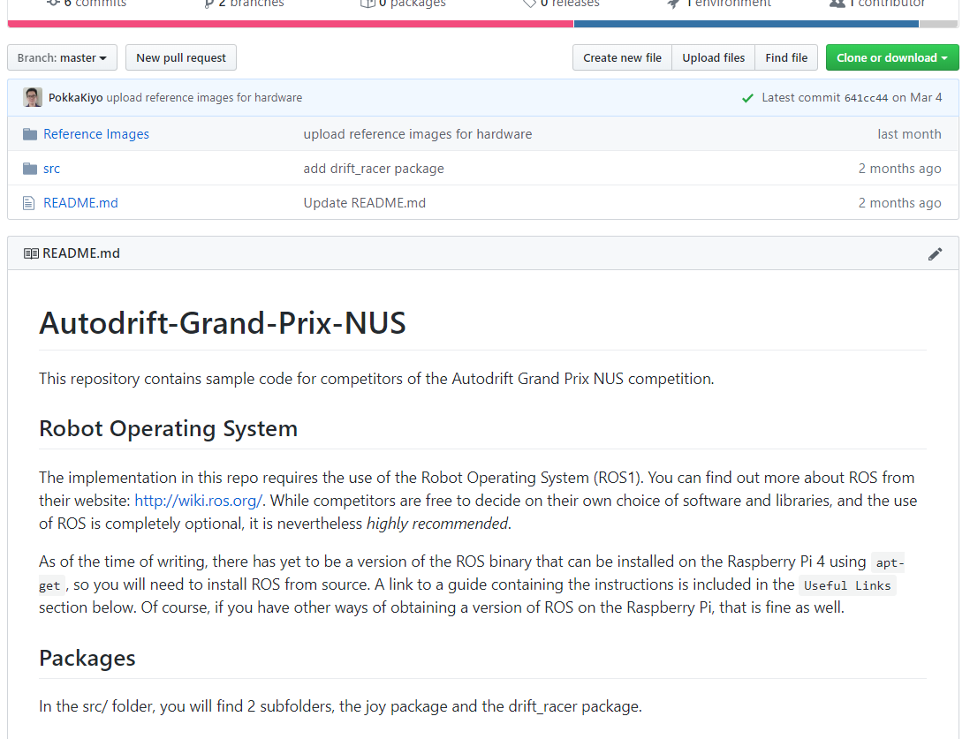
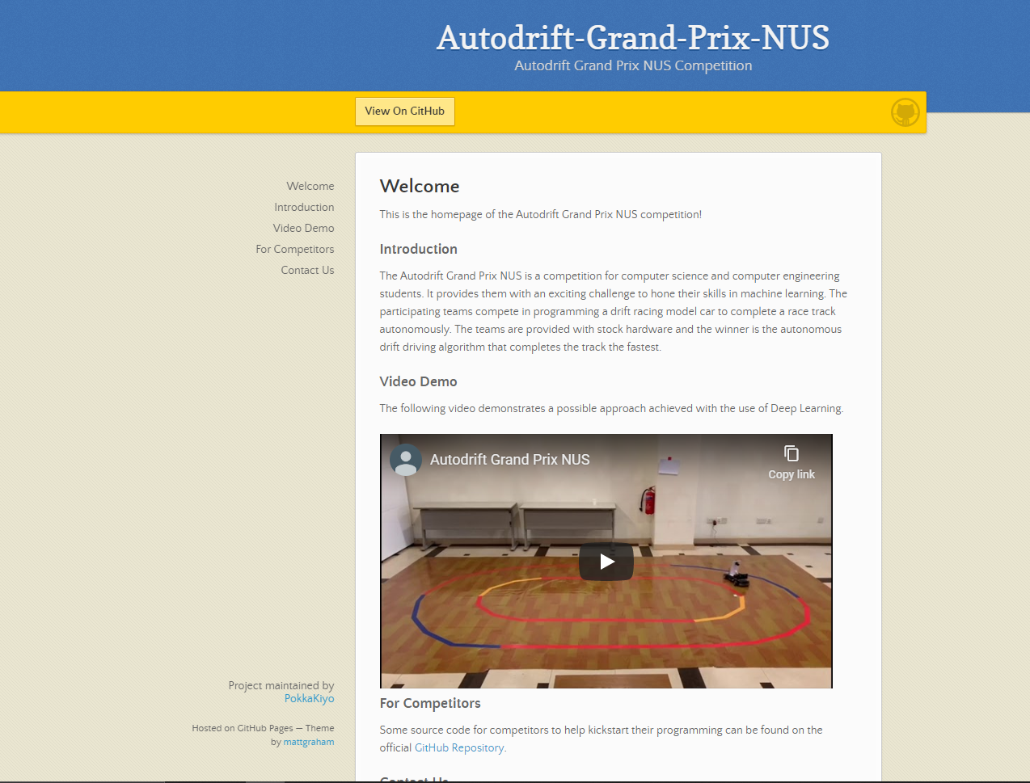
Software Repository
Sample code for students on GitHub
Implementation of Autonomous Navigation architecture, with some omission

Slide 56
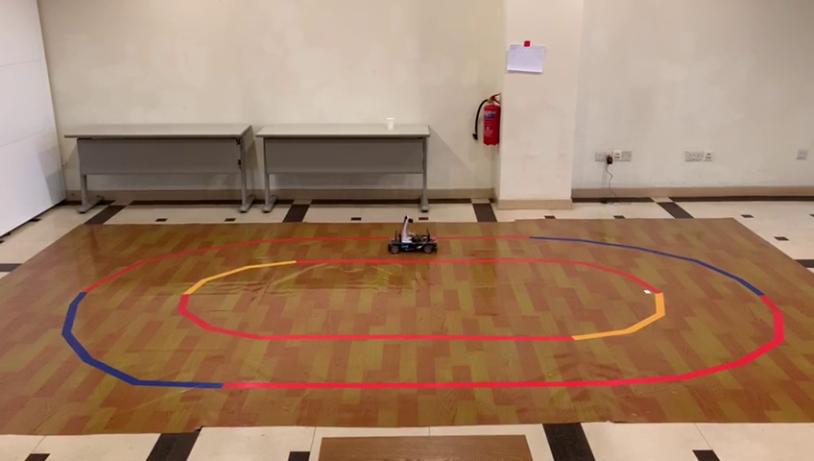
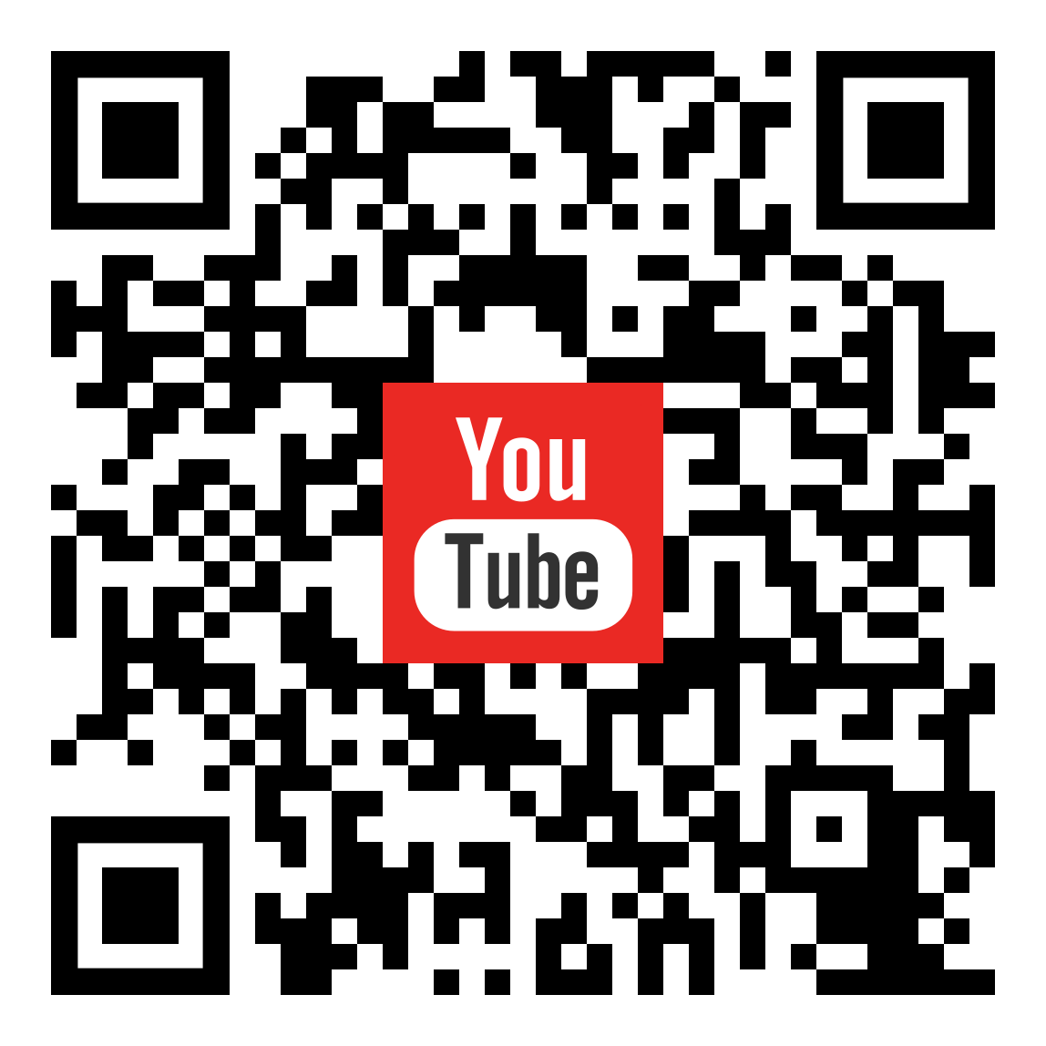
Vinyl Racetrack
Some work was done to put the track on vinyl sheet
Promotional Video on vinyl track to demonstrate feasibility

Slide 57
Competition Rules
Time Attack format
Each contestant has to complete 5 full rounds
Shortest time to do so wins
Each team given 3 attempts, to complete within 15 minutes
Need to be fully autonomous!
Details in report…

Slide 58
Deliverables
Design and implement an autonomous RC car competition, with drifting
Design racetrack
Competition format and rules
List of hardware
Prove feasibility with our contestant
Procuring hardware
Programming a drift controller

Slide 59
Deliverables
Design and implement an autonomous RC car competition, with drifting
Design racetrack
Competition format and rules
List of hardware
Prove feasibility with our contestant
Procuring hardware
Programming a drift controller

Slide 60
Conclusion
Introduction
Literature Review and Proposed Solution(s)
Overview of Implementation
Experiments and Methodology
Implementation of Competition
Conclusion

Slide 61

Conclusion
Demonstrated novel approach to drifting with a single camera
Process of track design through experiments
Implemented the competition

Slide 62
Recommendations for Further Work
More tracks
More in line with the Machine Learning framework
More cars in the race
More exciting!
More sensors
IMU, Wheel encoders, Lidar

Slide 63
Thank you!

